Slide 1
Jermyn Borough Council Meeting
08/21/2025

Slide 2

Meeting Agenda
JULY 24, 2025
CALL TO ORDER
PLEDGE OF ALLEGIANCE
ROLL CALL
PREVIOUS MEETING MINUTES
TREASURE REPORT/BILS PAYABLE
SECRETARY REPORT
CORRESPONDENCE
PUBLIC COMMENT
PROFESSIONAL REPORTS
COMMITTEE REPORTS
CODE ENFORCEMENT APPOINTMENT
NEW BUSINESS
ADJOURNMENT

Slide 3
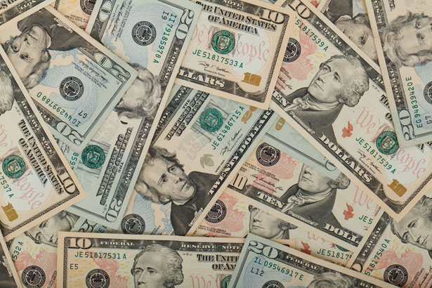
Treasurer’s report
7/24/2025
ASSETS
Checking/Savings
American Rescue Plan Fund 93,591.67
Capital Reserve - DPW 1,083.80
Capital Reserve - Police 6,629.82
Crime Watch Fund 222.69
General Fund - Community 92,579.06
General Fund - FNB 4,109.23
Holiday Lights Fund 400.59

Slide 4
Treasurer’s report
Investment - General Fund 1,145.46
Investment - Liquid Fuels 25,220.38
Investment - Paving Fund 1,157.37
Investment - Recycling 126.48
Investment - Refuse 180.37
Liquid Fuels - FNB 45,500.64
Petty Cash 194.00
Recreations Fund 30,365.33
Recycling - Community 7,274.74
Refuse Checking - FNB 263,383.50
Total Checking/Savings 573,165.13

Slide 5
Treasurer’s report
200000 · Accounts Payable 4,226.88
Long Term Debt None/ Paid in full

Slide 6


